Slide 1
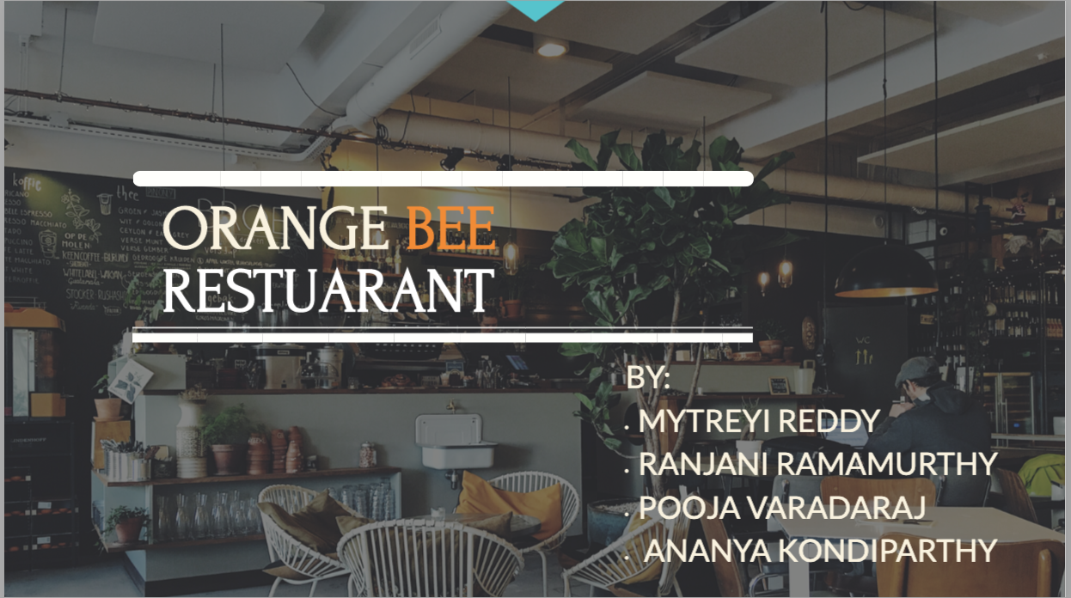

Slide 2
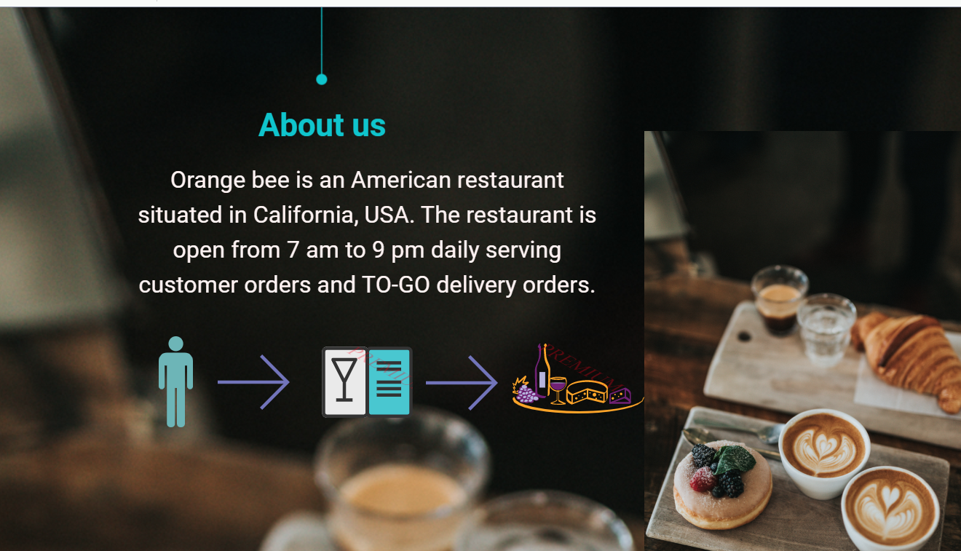

Slide 3
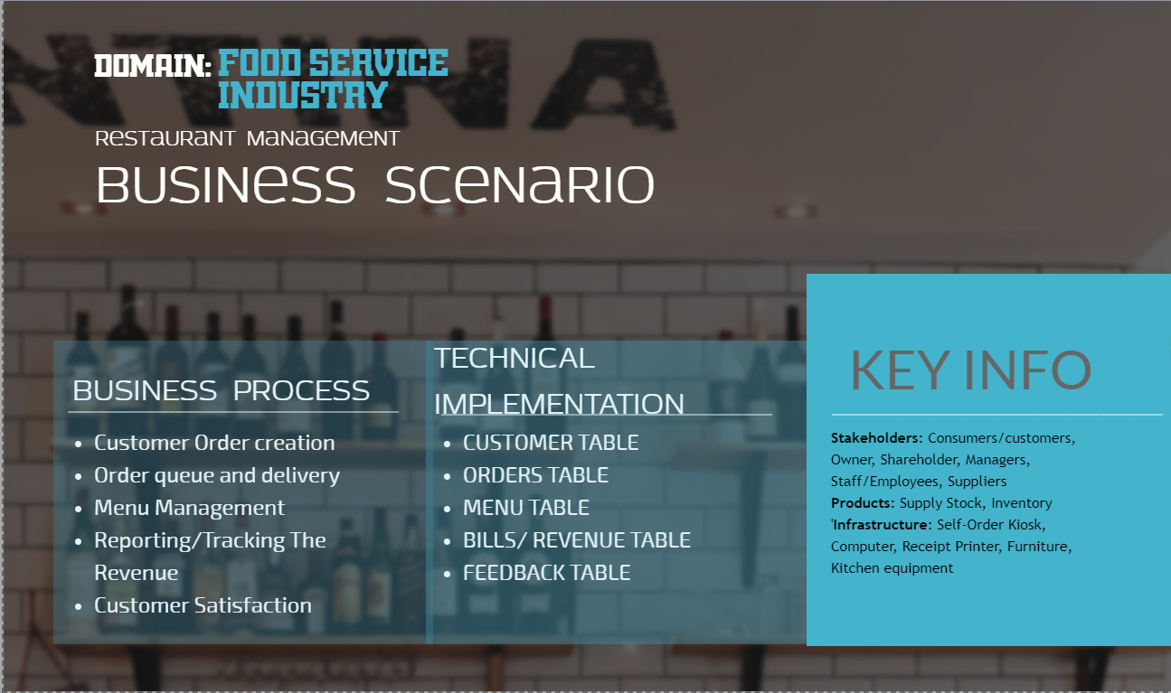

Slide 4
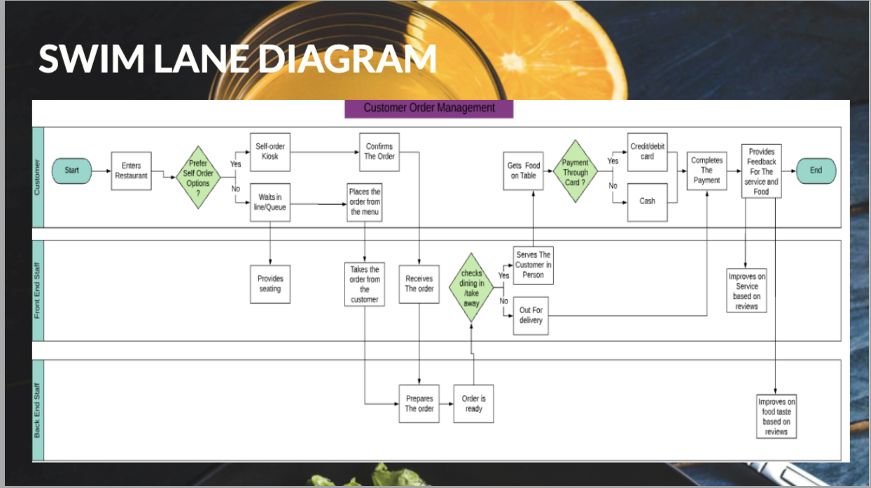

Slide 5
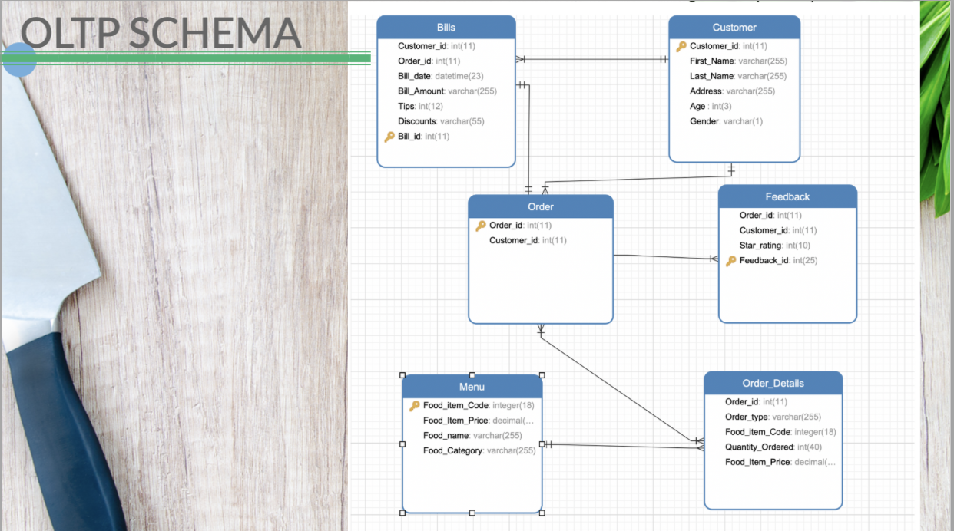

Slide 6
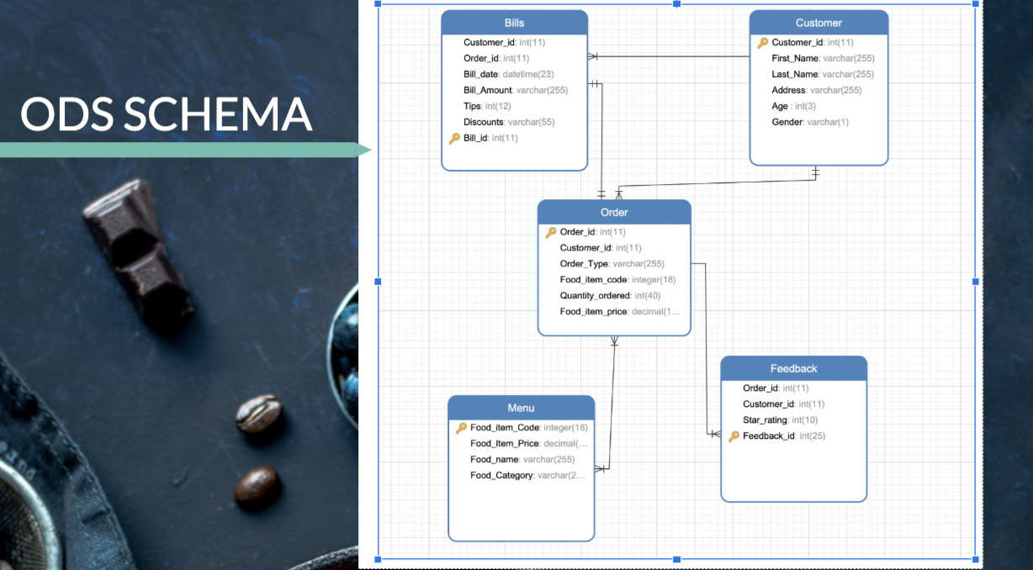

Slide 7
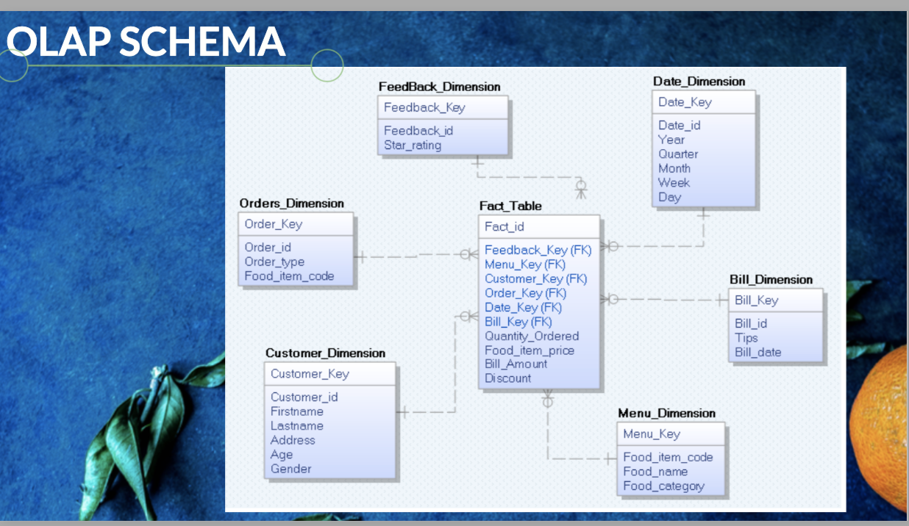
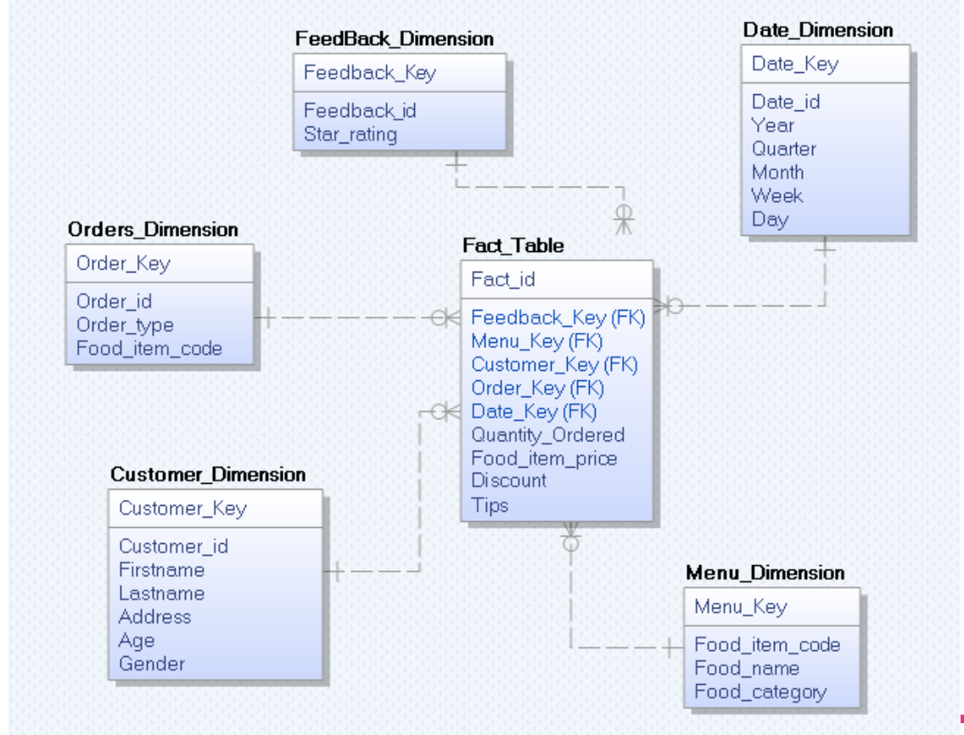
Notes:
Remove the screenshot as we need the fact table without

Slide 8
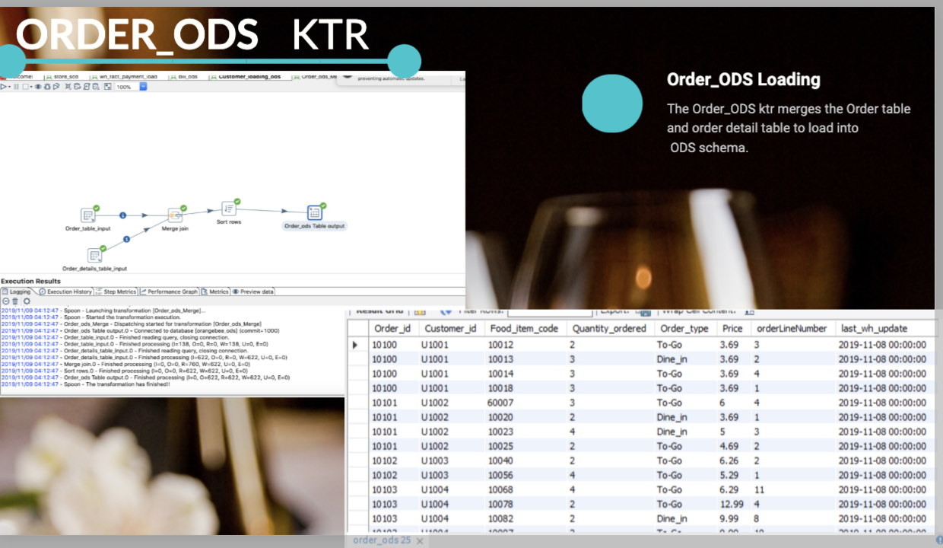

Slide 9
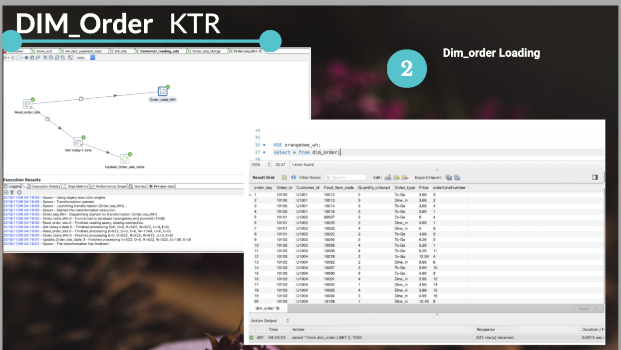

Slide 10
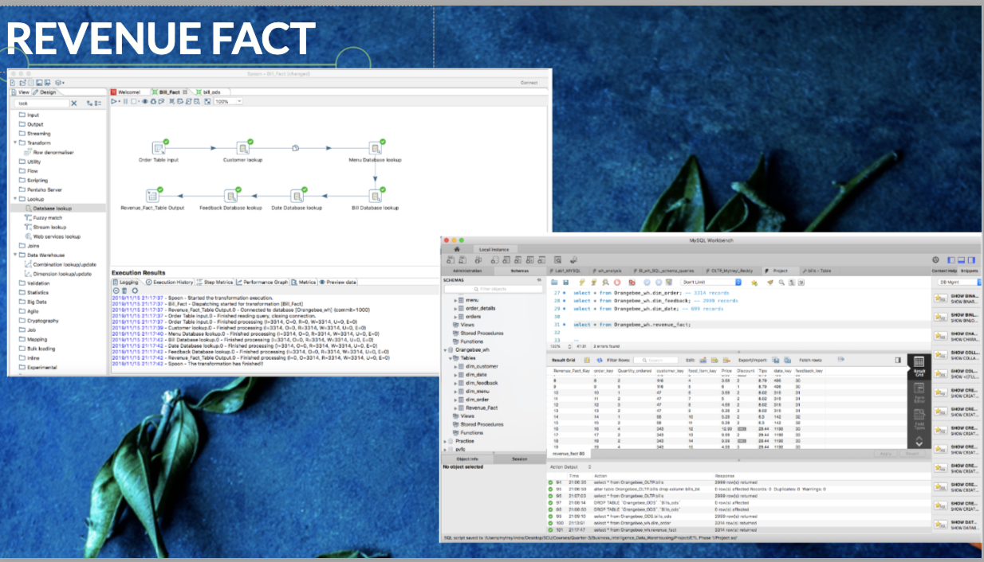

Slide 11
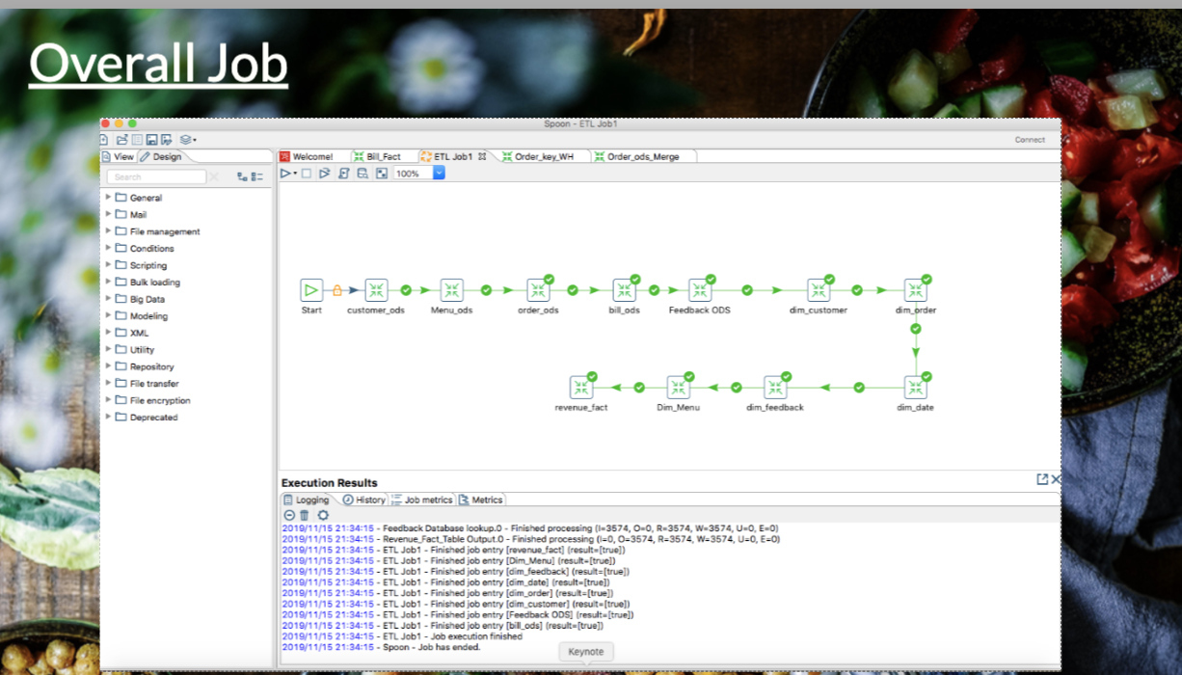
Revenue fact transformation

Slide 12
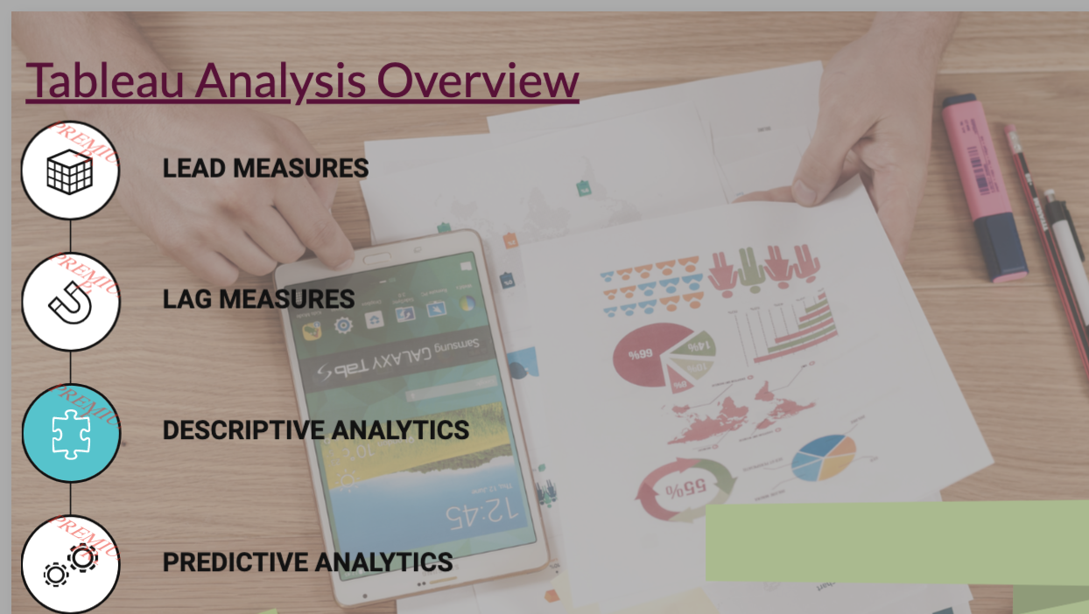
Link: https://public.tableau.com/profile/mytreyi.reddy#!/vizhome/Project_Final_OrangeBee/LagMeasures

Slide 13

Conclusion
Future Enhancements : Include Parameters such as Quantity Ordered, most preferred food items, specific highest revenue generated orders.
Improve everything from menus, staff training and marketing campaigns.
Analyze every datapoint , metrics related to the business.Convert them into meaningful insights.

